Slide 1
Introduction to Transfer Learning

Slide 2
A Major Assumption inTraditional Machine Learning
Training and future (test) data follow the same distribution, and are in same feature space
Notes:
In many realworld
applications, it is expensive or impossible to recollect
the needed training data and rebuild the models. It would be
nice to reduce the need and effort to recollect the training
data.

Slide 3

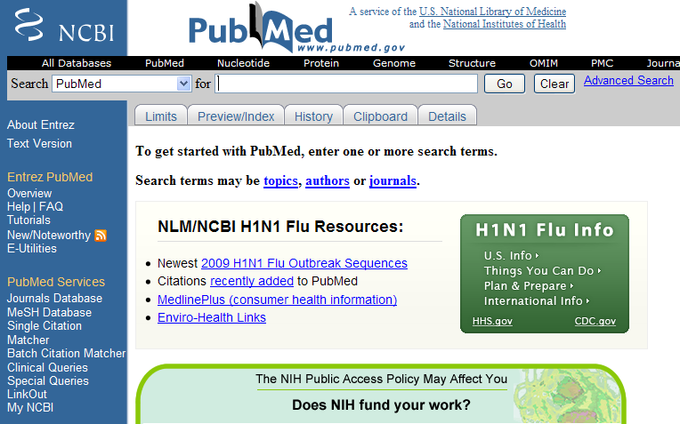
When distributions are different
Part-of-Speech tagging
Named-Entity Recognition
Classification
Notes:
3
Move to front? As distribution. Animation: applictation/tracking

Slide 4
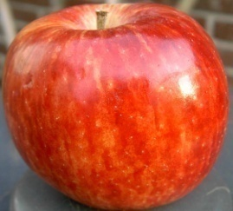
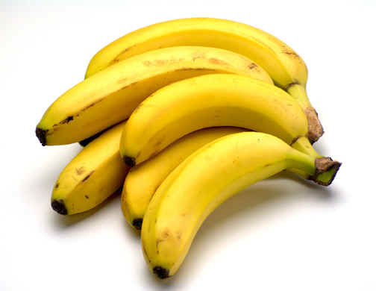
When Features are different
Heterogeneous: different feature spaces
Training: Text
Future: Images
The apple is the pomaceous fruit of the apple tree, species Malus domestica in the rose family Rosaceae ...
Apples
Banana is the common name for a type of fruit and also the herbaceous plants of the genus Musa which produce this commonly eaten fruit ...
Bananas

Slide 5
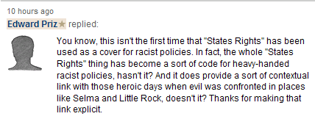


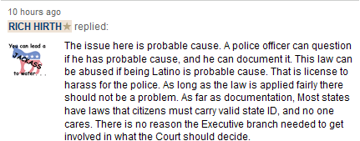
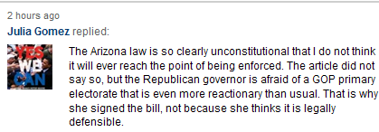

Motivating Example: Sentiment Classification

Slide 6


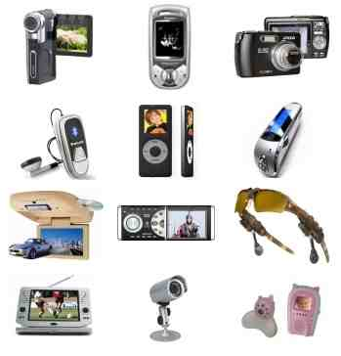
Traditional Supervised Learning
DVD
DVD
Training
Test
Classifier
82.55%
1, Sufficient labeled data are required to train classifiers. 2, The trained classifiers are domain-specific.
Electronics
Electronics
Training
Test
Classifier
84.60%

Slide 7
Traditional Supervised Learning (cont.)
Drop!
Electronics
Electronics
Training
Test
Classifier
84.60%
DVD
Electronics
Training
Test
Classifier
72.65%

Slide 8
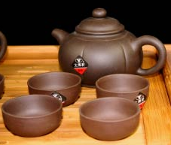
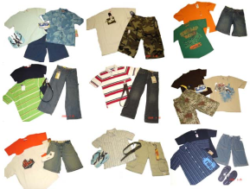

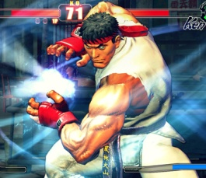

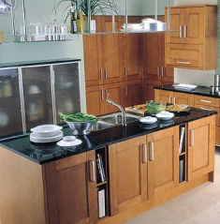
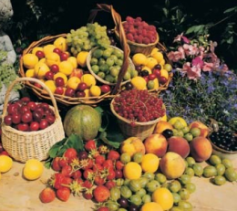
Traditional Supervised Learning (cont.)
Impractical!
Electronics
Tea
DVD
Clothes
Book
Video game
Hotel
Kitchen
Fruit

Slide 9
Domain Difference
Electronics | Video Games
(1) Compact; easy to operate; very good picture quality; looks sharp! | (2) A very good game! It is action packed and full of excitement. I am very much hooked on this game.
(3) I purchased this unit from Circuit City and I was very excited about the quality of the picture. It is really nice and sharp. | (4) Very realistic shooting action and good plots. We played this and were hooked.
(5) It is also quite blurry in very dark settings. I will never buy HP again. | (6) The game is so boring. I am extremely unhappy and will probably never buy UbiSoft again.

Slide 10
Transfer Learning?
People often transfer knowledge to novel situations
Chess → Checkers
C++ → Java
Physics → Computer Science
Transfer Learning:
The ability of a system to recognize and apply knowledge and skills learned in previous tasks to novel tasks (or new domains)
Notes:
Seems the changes is involved in moving to new tasks is more radical than moving to new domains.

Slide 11
Transfer Learning: Source Domains
Learning
Input
Output
Source Domains
 | Source Domain | Target Domain
Training Data | Labeled/Unlabeled | Labeled/Unlabeled
Test Data |  | Unlabeled

Slide 12
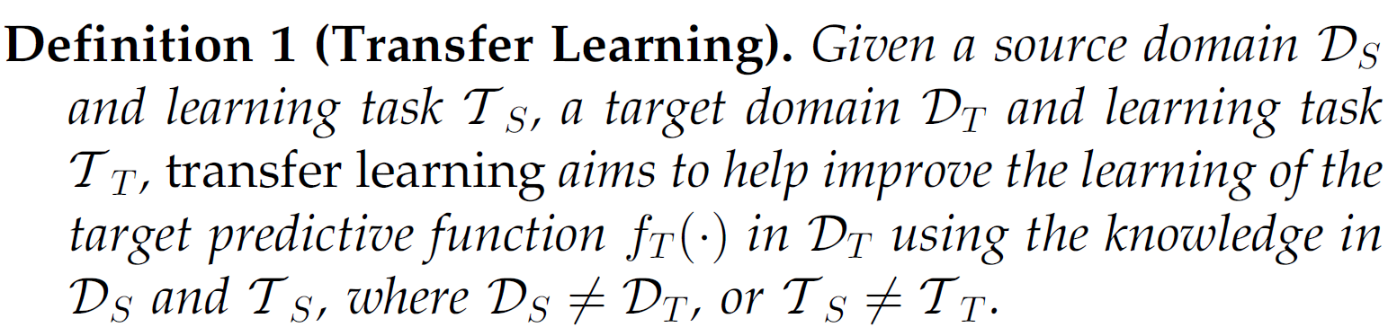
A unified definition of transfer learning

Slide 13
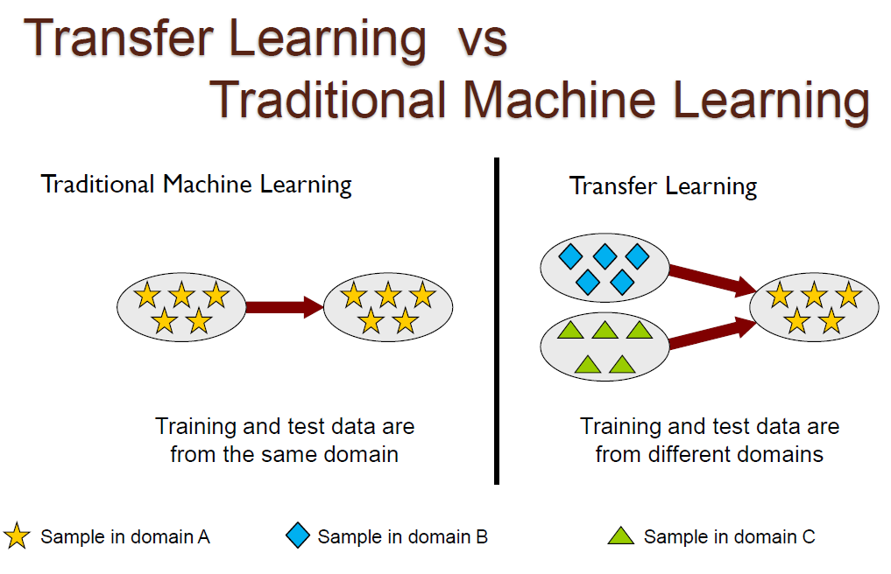

Slide 14
Relationship between Traditional Machine Learning and Various Transfer Learning Settings
Learning Settings |  | Source and Target Domains | Source and Target Tasks
Traditional Machine Learning |  | The same | The same
Transfer Learning | Inductive Transfer Learning / Unsupervised Transfer Learning | The same | Different but related
 |  | Different but related | Different but related
 | Transductive Transfer Learning | Different but related | The same

Slide 15
An overview of
various settings of
transfer learning
Source Domain
Self-taught Learning
Case 1
No labeled data in a source domain
Inductive Transfer Learning
Target Domain
Labeled data are available in a source domain
Labeled data are available in a target domain
Source and target tasks are learnt simultaneously
Multi-task Learning
Case 2
Transfer Learning
Labeled data are available only in a source domain
Assumption: different domains but single task
Transductive Transfer Learning
Domain Adaptation
No labeled data in both source and target domain
Assumption: single domain and single task
Unsupervised Transfer Learning
Sample Selection Bias /Covariance Shift

Slide 16
Different Settings of Transfer Learning
Transfer Learning Settings | Related Areas | Source Domain Labels | Target Domain Labels | Tasks
Inductive Transfer Learning | Multi-task Learning | Available | Available | Regression, Classification
 | Self-taught Learning | Unavailable | Available | Regression, Classification
Transductive Transfer Learning | Domain Adaptation, Sample Selection Bias, Co-variate Shift | Available | Unavailable | Regression, Classification
Unsupervised Transfer Learning |  | Unavailable | Unavailable | Clustering, Dimensionality Reduction

Slide 17
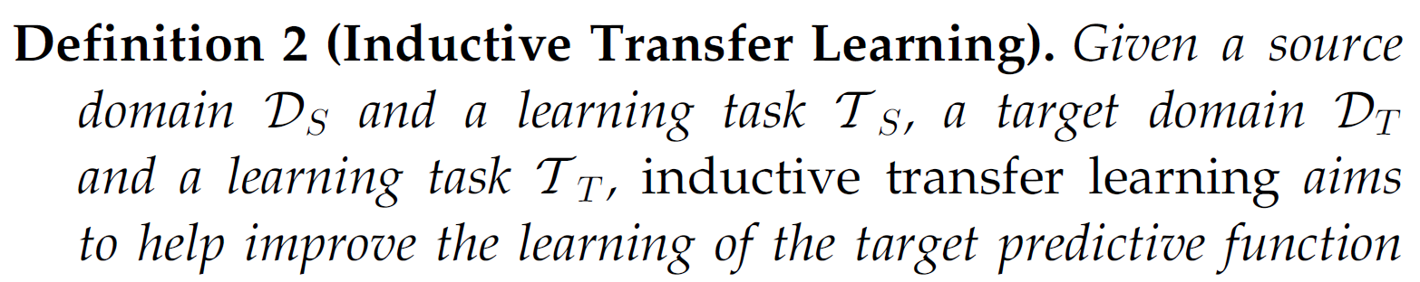
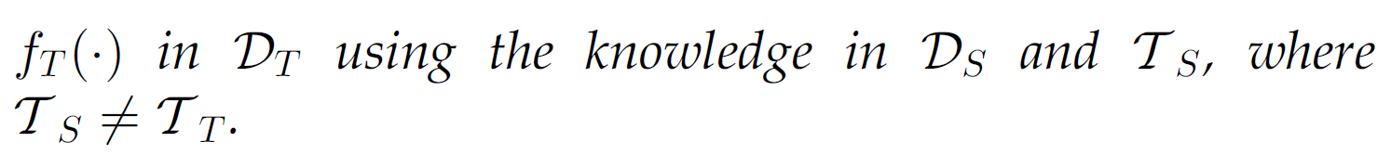
Definition of Inductive Transfer Learning

Slide 18
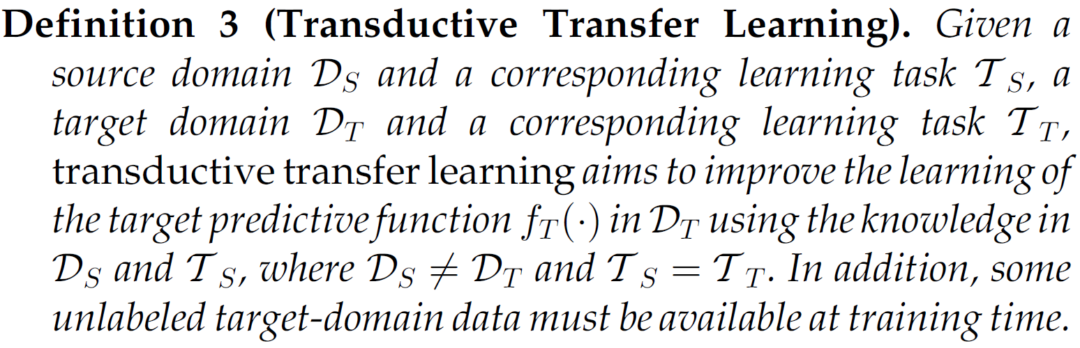
Definition of Transductive Transfer Learning

Slide 19
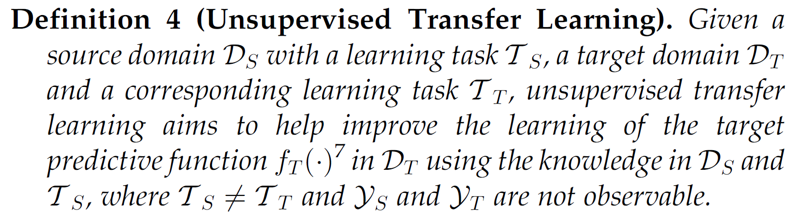
Definition of Unsupervised Transfer Learning

Slide 20
Different approaches
Based on “what to transfer”
Four cases
Instance-transfer
Feature-representation-transfer
Parameter-transfer
Relational-knowledge-transfer

Slide 21
Instance transfer
To re-weight some labeled data in the source domain for use in the target domain
Instance sampling and importance sampling are two major techniques in instance-based transfer learning method.

Slide 22
Feature-representation-transfer
To learn a “good” feature representation for the target domain.
The knowledge used to transfer across domains is encoded into the learned feature representation.
With the new feature representation, the performance of the target task is expected to improve significantly.

Slide 23
Parameter-transfer
Assume that the source tasks and the target tasks share some parameters or prior distributions of the hyperparameters of the models
The transferred knowledge is encoded into the shared parameters or priors.
By discovering the shared parameters or priors, knowledge can be transferred across tasks.

Slide 24
Relational-knowledge-transfer
Some relationship among the data in the source and target domains is similar.
The knowledege to be transferred is the relationship among the data.
Statistical relational learning techniques dominate this context.

Slide 25
Different apporaches used in different settings
 | Inductive Transfer Learning | Transductive Transfer Learning | Unsupervised Transfer Learning
Instance-transfer | √ | √
Feature-representation-transfer | √ | √ | √
Parameter-transfer | √
Relational-knowledge-transger | √

Slide 26
Three major issues
What to transfer?
asks which part of knowledge can be transferred across domains or tasks.
Some knowledge is specific for individual domains or tasks, and some knowledge may be common between different domains such that they may help improve performance for the target domain or task.

Slide 27
How to transfer?
After discovering which knowledge can be transferred, learning algorithms need to be developed to transfer the knowledge, which corresponds to the“how to transfer” issue.

Slide 28
When to transfer?
asks in which situations, transferring skills should be done.
in which situations, knowledge should not be transferred.
In some situations, when the source domain and target domain are not related to each other, brute-force transfer may un-succeed.
In the worst case, it may even hurt the performance of learning in the target domain, a situation which is often referred to as negative transfer.

Slide 29
Some SVM-based transfer learning methods

Slide 30
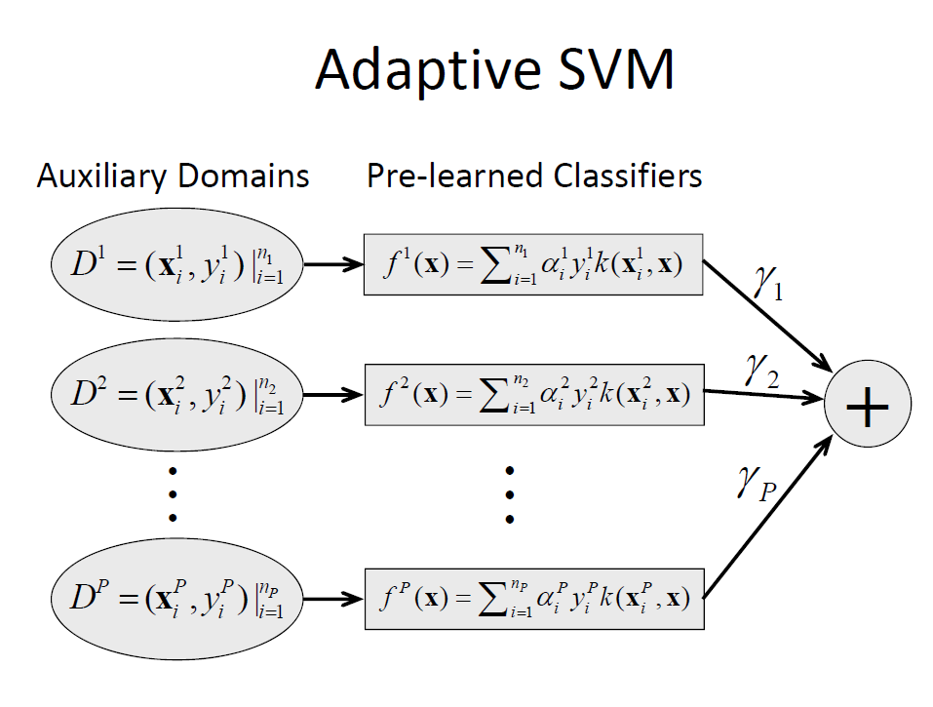

Slide 31
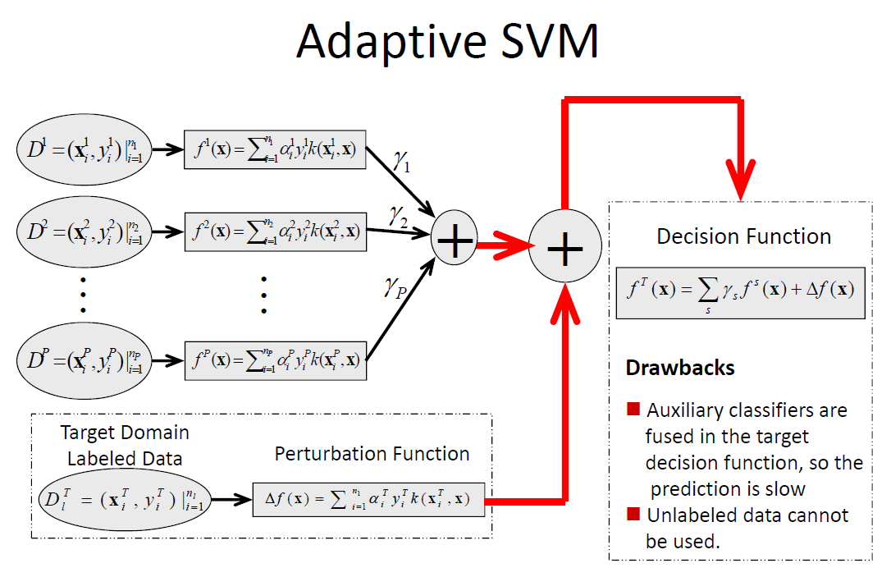

Slide 32
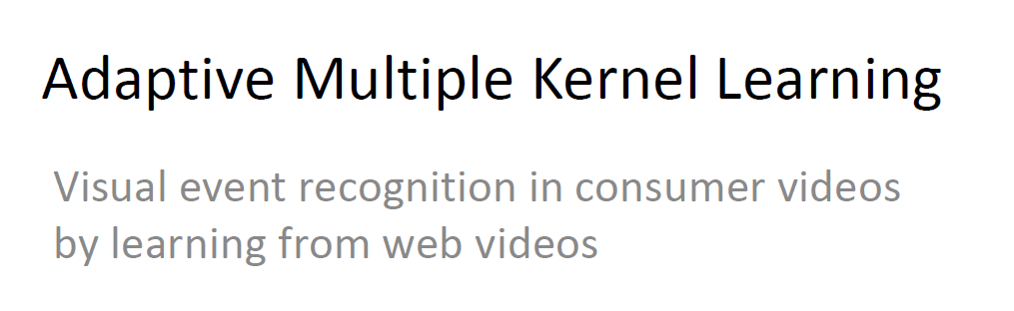

Slide 33
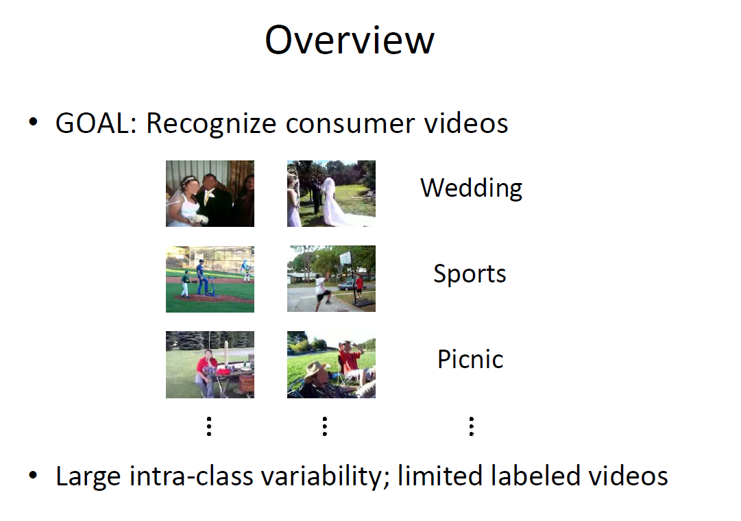

Slide 34
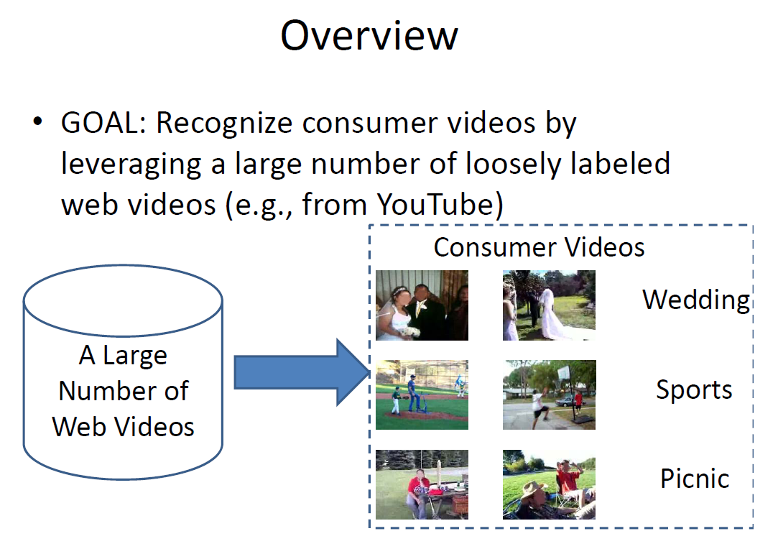

Slide 35
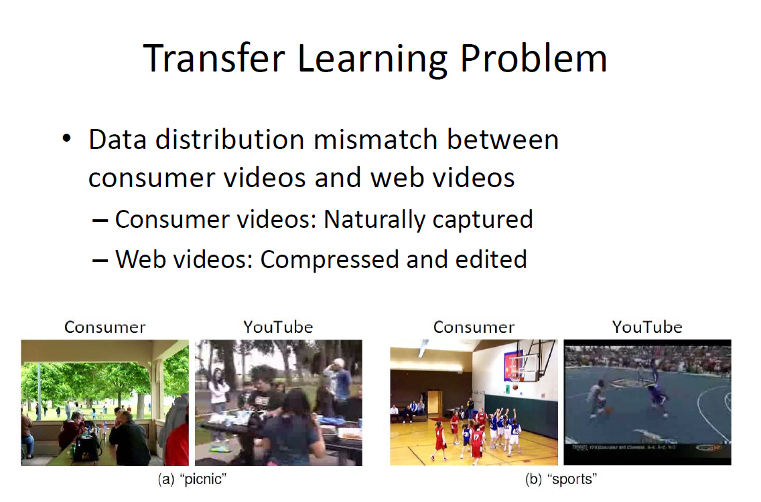

Slide 36
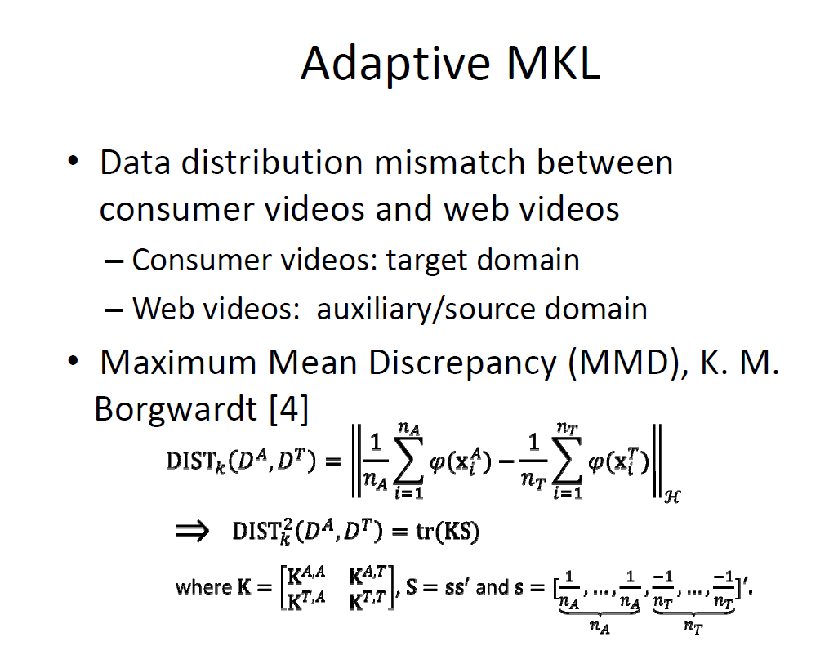

Slide 37
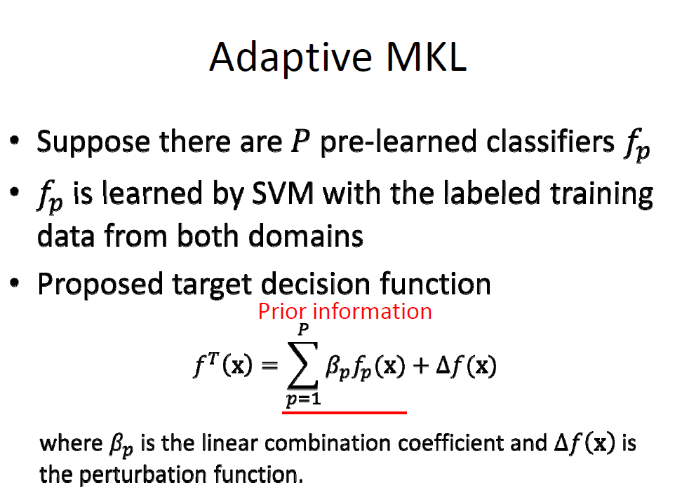

Slide 38
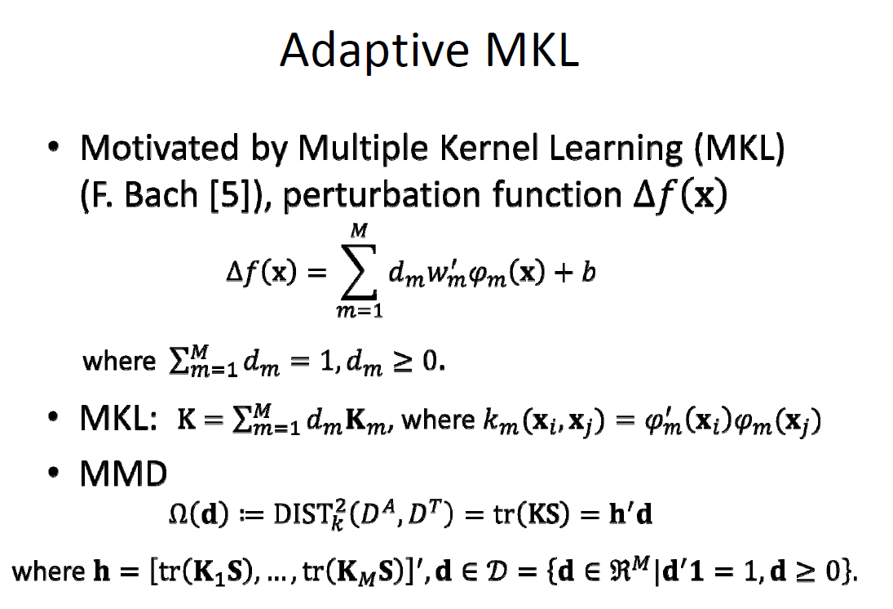

Slide 39
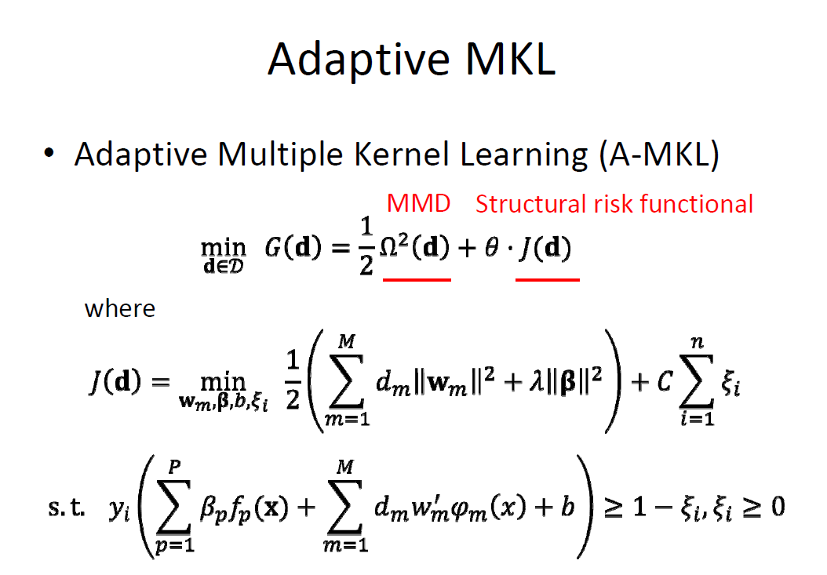

Slide 40
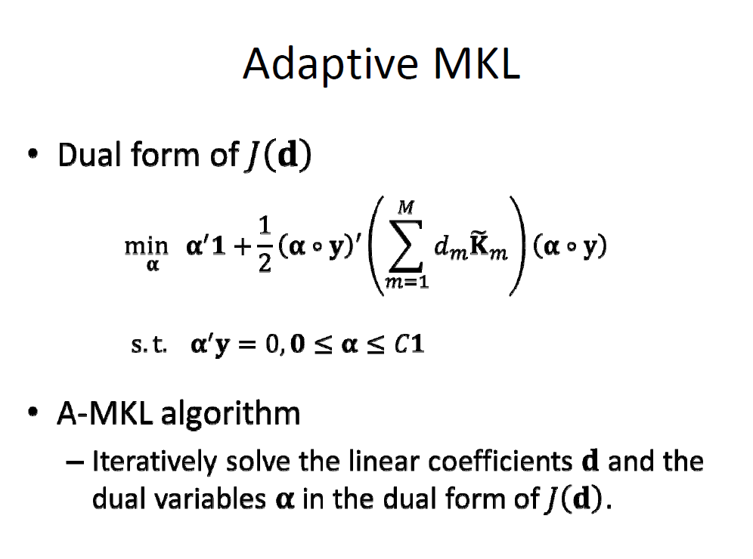

Slide 41
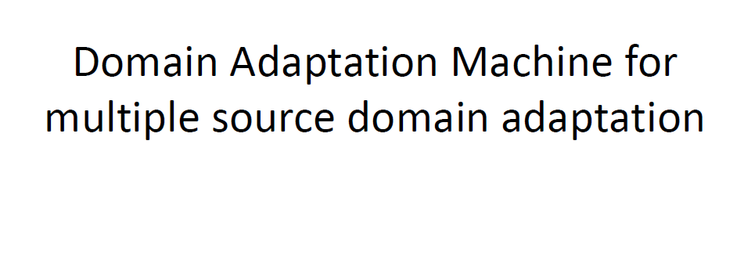

Slide 42
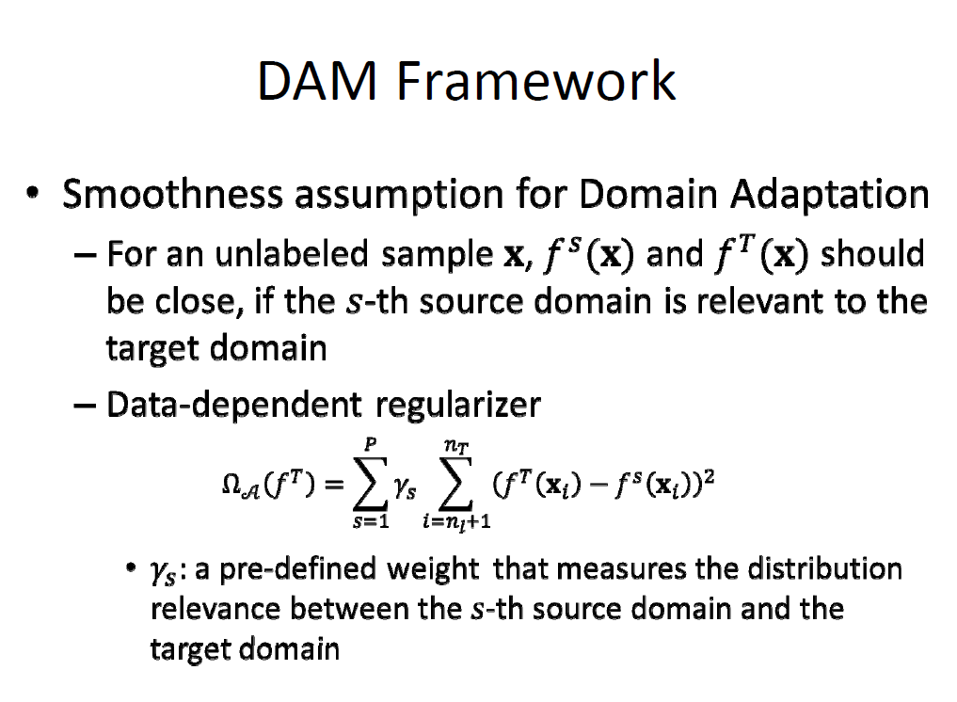

Slide 43
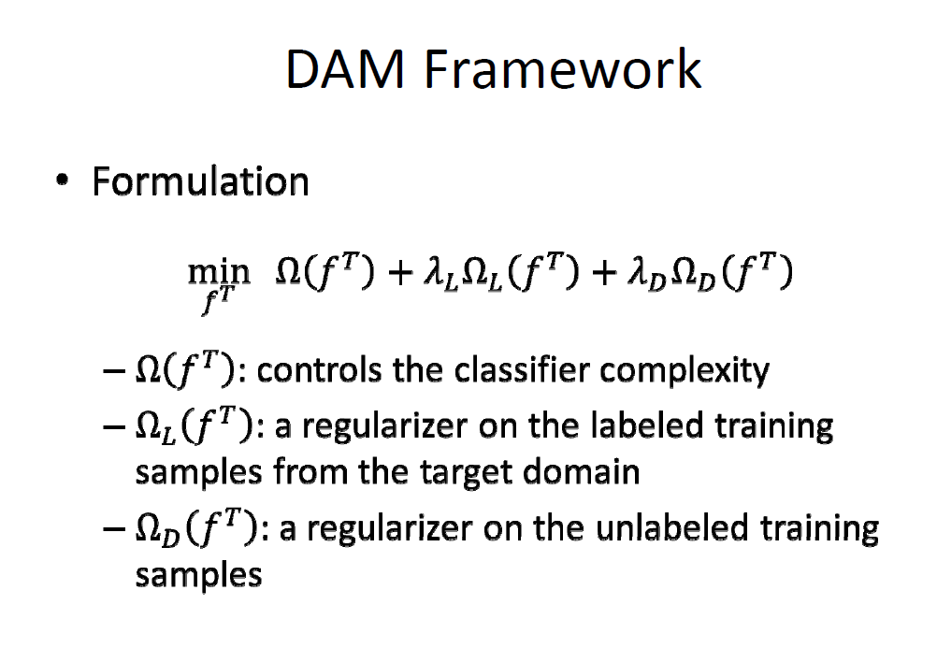

Slide 44
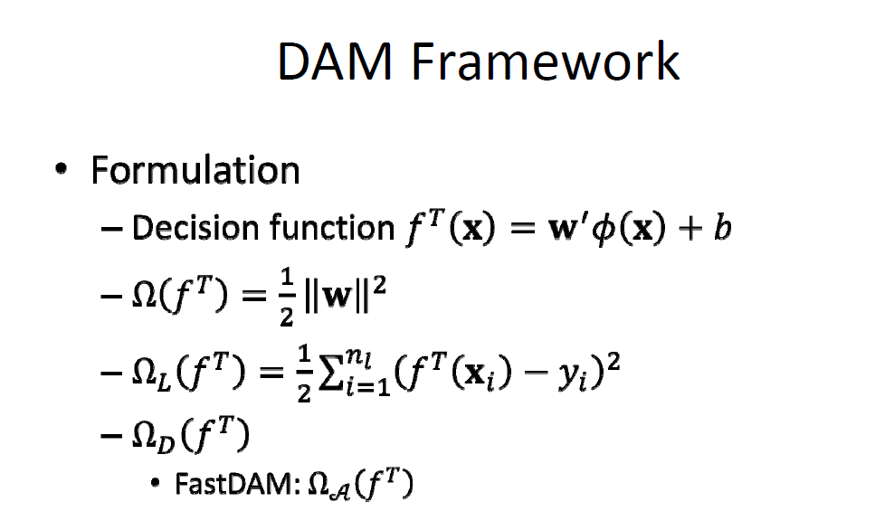

Slide 45
